Slide 1

National Integrated Services Framework
The Foundation for Future e-Health Connectivity
Peter Connolly
HSE
March 2014

Slide 2
The Integrated Services Framework (ISF)
Secondary
A
‘
standards based
Secondary
’
•
A Technical Architecture
•
A Technical Architecture
Deliverable
single framework for the
Deliverable
•
An Applications Architecture
public health system
•
An Applications Architecture
•
An Information Model and Architecture
•
An Information Model and Architecture
•
An Communications / Network Architecture
•
An Communications / Network Architecture
Foundation for the
Foundation for the
Electronic Health
Electronic Health
Record (EHR) and
•
Deliver the ICT Strategy work streams
Record (EHR) and
A Single Information
•
Deliver the ICT Strategy work streams
a National Patient/
Systems Framework to
•
Strategic National Business Initiatives
a National Patient/
•
Strategic National Business Initiatives
Client Portal
provide for
integration
•
Develop, implement & support
Client Portal
•
Develop, implement & support
and sharing of data
•
local & regional initiatives
•
local & regional initiatives
and information
•
Develop the EHR Information Framework
•
Develop the EHR Information Framework
•
Develop & improve ICT Infrastructure
•
Develop & improve ICT Infrastructure

Slide 3
The Integrated Services Framework (ISF)
Vision
Work-stream-1: The Framework Model………………………......5
Technical Infrastructure
Work-stream-2: Technical Infrastructure Work Stream……………7
(ICT Platforms, Technologies & Asset Base)
Work-stream-3: Applications Reference Base…………………....10
(Applications Portfolio, Standards & Toolsets)
Work-stream-4: Integrated Systems Management Framework…13
Information Architecture
Work-stream-5: High Level Business Process Specification….....15
Work-stream-6: Information Architecture Model……………….…18
Work-stream-7: Data & Information Repository…………..…..….. 21
Work-stream-8: Transformation, Interfacing & Sourcing………....23
Access
Work-stream-9: Identity, Access & Consent Management……...25
Work-stream-10: Portal & Presentation ……………………….….28
Governance
Work-stream-11: Architecture Documentation……………………30
Work-stream-12: Governance Model ……………………………..33
Appendix
Blueprint of the Integrated Services Framework……………………...34
STRATEGIC
TECHNICAL
ROADMAP
ARCHITECTURE
WS:1
WS:2-4
INTEGRATED SERVICES FRAMEWORK
(ISF)
INFORMATION
GOVERNANCE
ARCHITECTURE
WS:11-12
WS:5-8
ACCESS
WS:9-10

Slide 4
Stakeholder Requirements
  Integration and connectivity of disparate applications and data
  Horizontal integration of legacy systems
  Leverage information from heterogeneous systems
  Integration that is scalable
  A component based architecture
  Loosely coupling
  Fast & efficient deployment

Slide 5
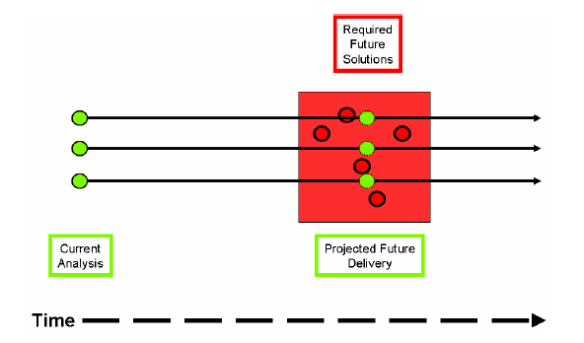
The Problem
Courtesy of NEHTA

Slide 6
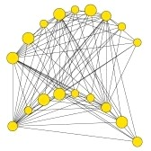
Example of an Information Challenge
The NICIS will be used to capture all immunisation events including national childhood immunisation programmes (including schools), outbreaks, campaigns, late entrants, adult vaccinations and pandemic response. In addition the system should allow for the recording of client information relating to neonatal and metabolic screening, breast feeding and developmentals.
The NICIS system will require data sharing with a broad range of systems including-
The Maternal and Newborn Clinical Management System (MN-CMS) (and prior to that being in place to the Dublin Maternity Hospitals
The National Client Identity Services
Health Service Provider
GP practice management systems
National Cold Chain Delivery System
Primary Care Reimbursement Services (PCRS)
National Cancer Service
The National Childcare System
Department of Social and Family Affairs
The National Newborn Bloodspot Screening
Laboratory (NNBSL),
Universal Neonatal Hearing Screening (UNHS)

Slide 7

Tender Deliverables
Determination of the Information Model
Specification for the Data Dictionary
Terminology Assurance
Support Processes & Services

Slide 8
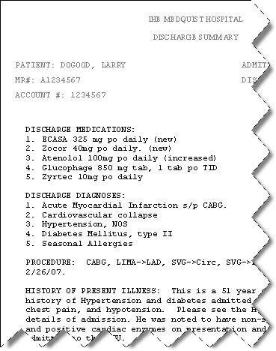
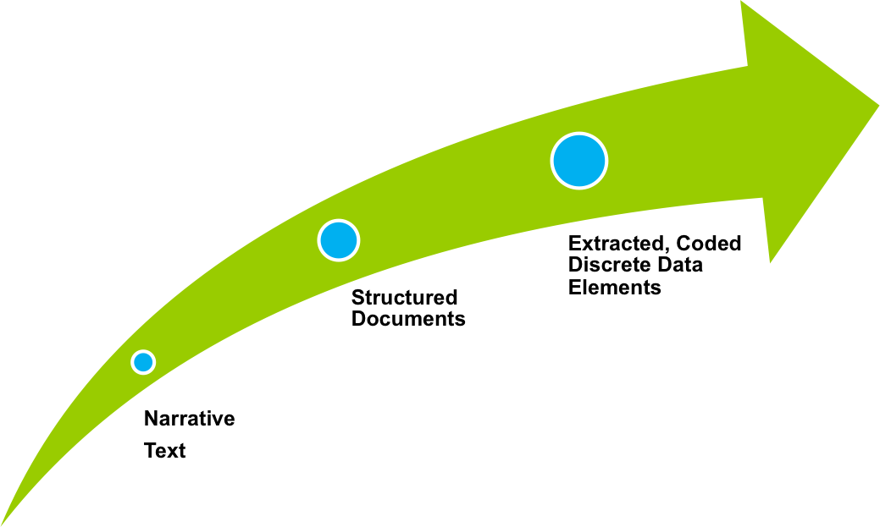
Proof-of-Concept (SAM)
Disease, DF-00000
Metabolic Disease, D6-00000
SAM Repository
Disorder of carbohydrate metabolism, D6-50000
Disorder of glucose metabolism, D6-50100
Diabetes Mellitus, DB-61000
Neonatal, DB75110
Type 1, DB-61010
Carpenter Syndrome, DB-02324
Clinical Applications
Insulin dependant type IA, DB-61020
Value
Data Dictionary Portal
Integrate
Validate & Publish
Proof-of-Concept

Slide 9
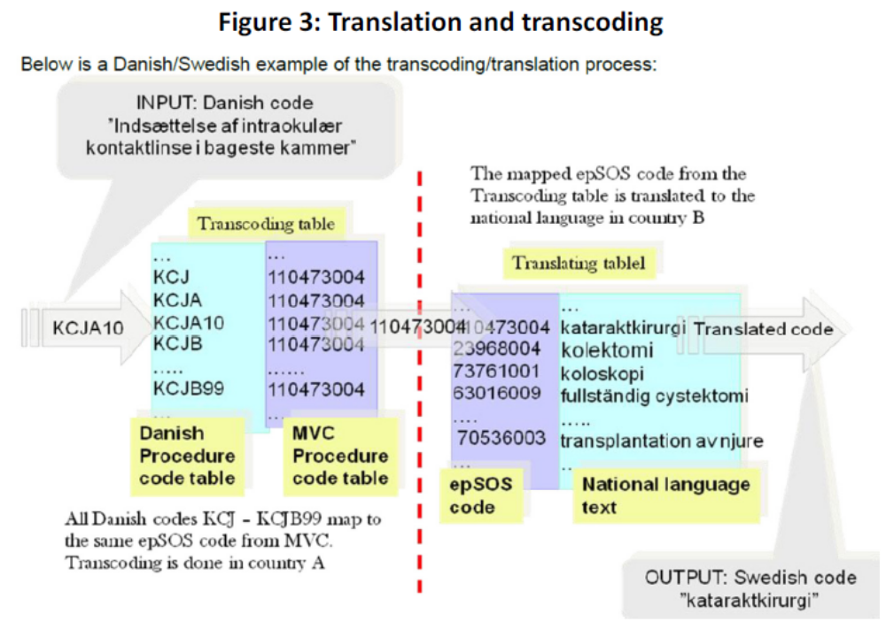
Directive 2011/24/EU

Slide 10

Stakeholder Engagement
Workshops
Interviews
Questionnaires
Feedback Sessions
Demonstrations

Slide 11
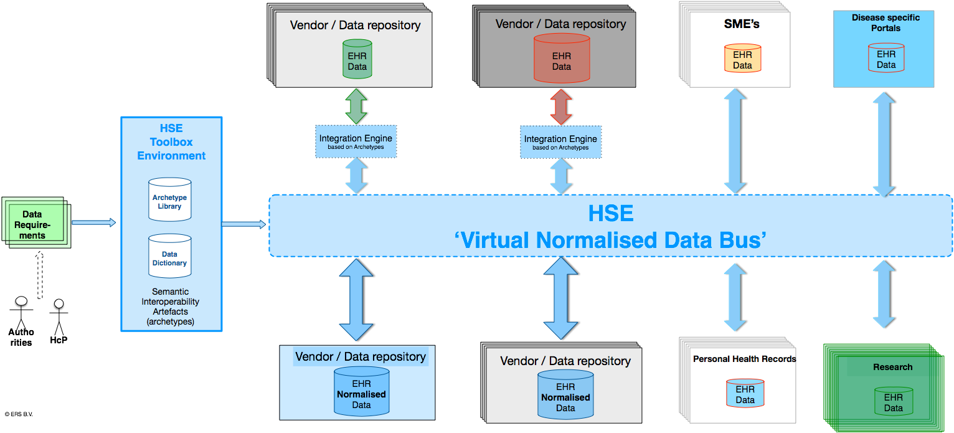
Information Architecture Reference Model (IA-RM)
MedDRA; HL7 E2B; ISO IDMP
WHO ATC/DDD;
WHO INN (International Nonproprietary Names)
LOINC (Lab) and ICPC2
Healthlink messaging - HL7v2, XML
ICD10 and Health One dictionary
PICNIC; loosely based on HL7v1 (not a standard)
Edifact (ebXML)
IPU codes/ATC/GMS -IPU product file
System 1
System 2
System 3
System 4
GS1
Snomed CT
Contsys
HISA
ISO 13606
HL7 -
Functional Model
IS0 21090
SAM 1
SAM 2
SAM 3
SAM 4
SAM 5
SAM 6
SAM 7
System 5
System 6
System 7
System 8

Slide 12
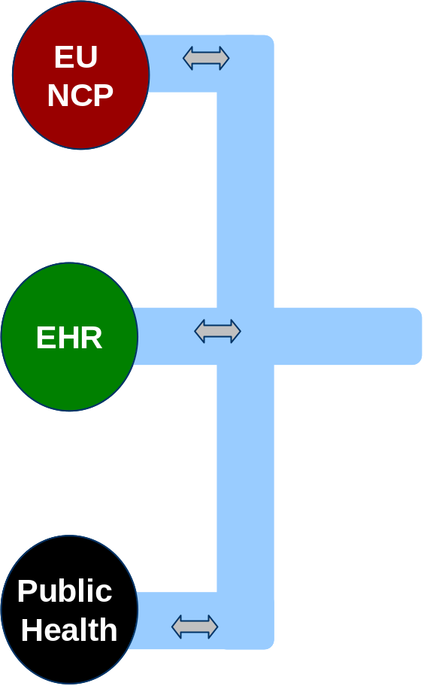
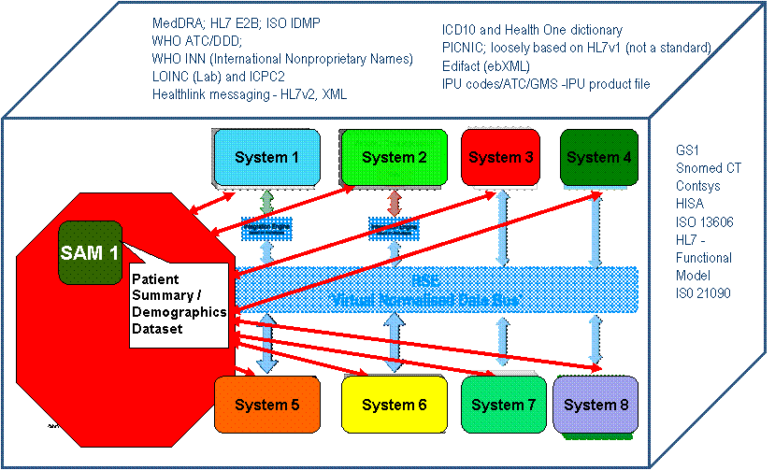
National Information Architecture (IA-RM)

Slide 13
Information Architecture Reference Model (IA-RM)
MedDRA; HL7 E2B; ISO IDMP
WHO ATC/DDD;
WHO INN (International Nonproprietary Names)
LOINC (Lab) and ICPC2
Healthlink messaging - HL7v2, XML
ICD10 and Health One dictionary
PICNIC; loosely based on HL7v1 (not a standard)
Edifact (ebXML)
IPU codes/ATC/GMS -IPU product file
System 1
System 2
System 3
System 4
GS1
Snomed CT
Contsys
HISA
ISO 13606
HL7 -
Functional Model
IS0 21090
SAM 1
Patient
Summary /
Demographics
Dataset
System 5
System 6
System 7
System 8

Slide 14
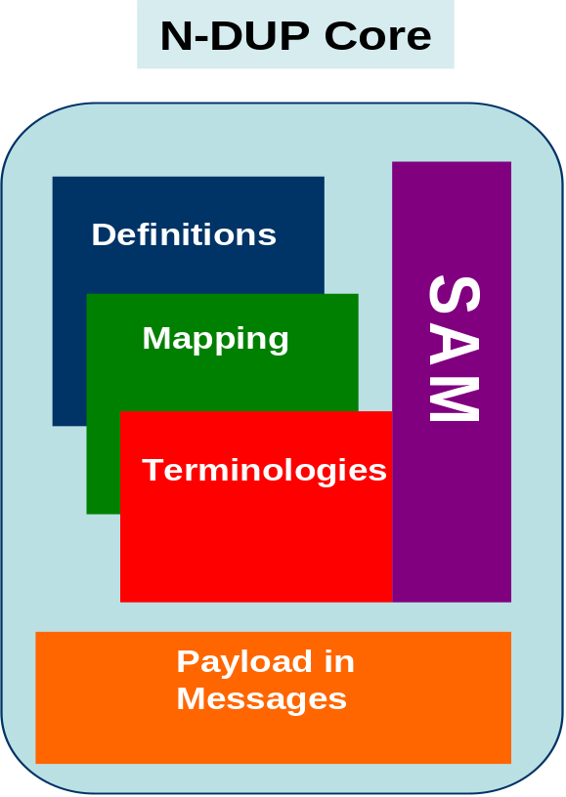
National Data Utility Platform
HL7 2.4
CDA
ISO 13606

Slide 15
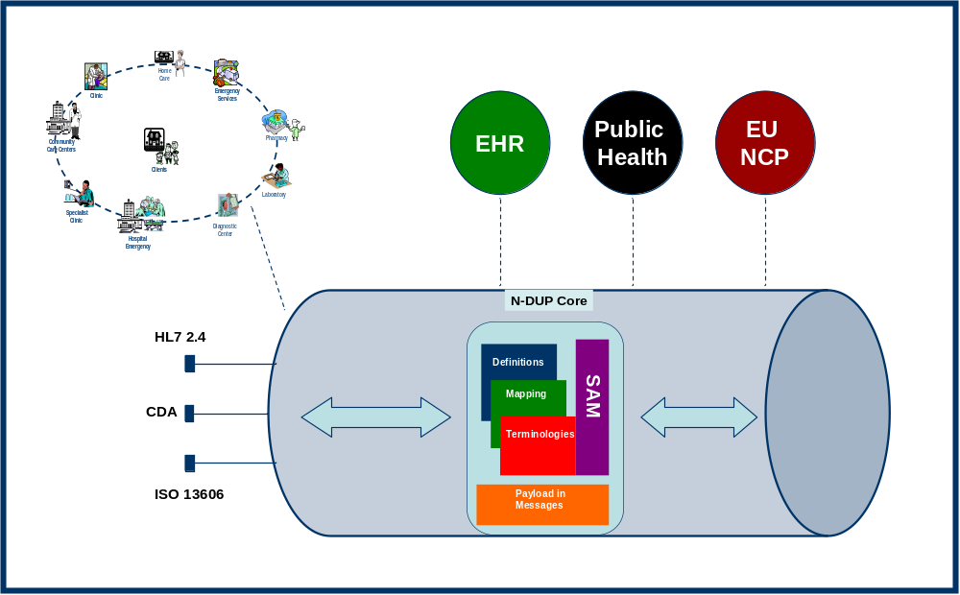
National Data Utility Platform

Slide 16
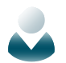











Deployment
Standards Guidance
Primary
Public Health
Others
Procurement
Standards
Data Structure
Data Types
Business Case
Technical &
Information Architecture
Vendor Selection
Delivery
Maintenance
Delivery Platform
Stakeholders
Data
Requirements
Data Dictionary
Terminology Binding
Data Registry/
Repository
ICT Delivery
Implementation &
Integration Services
Application
Services

